Slide 1

Power Curve Working Group Update
New Orleans
15th September 2015

Slide 2
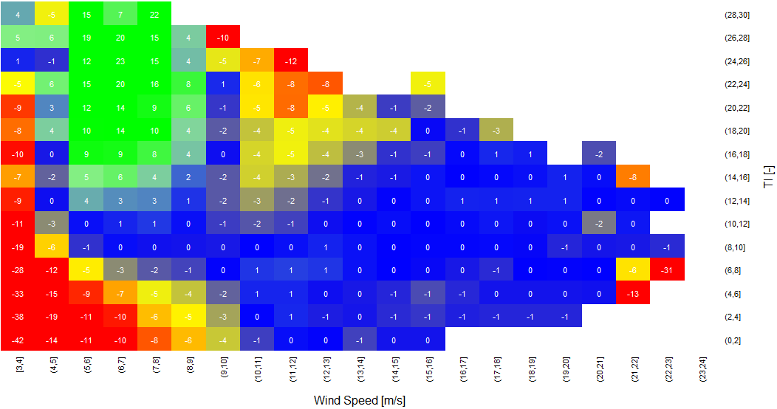
The Power Curve Working Group
The PCWG aims to further refine the accuracy energy yield predictions to improve investor confidence.
The PCWG has over 200 members across 80 organisations.
The PCWG is focused on accurately predicting wind turbine performance in ‘non-standard’ (outer range) atmospheric conditions e.g. low/high shear/veer, low/high turbulence, inflow etc.
Colour = % Power Deviation
Turbulence Intensity [%]
Wind Speed [m/s]

Slide 3
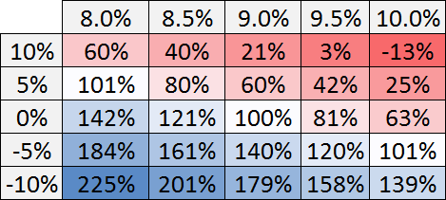
Impact of Investment Risk on Project Economics
Investors quantify risk using a discount rate (also called a hurdle rate). The discount rate expresses an expectation of return for a given level of risk.
Net present value (NPV) can be interpreted as the money left over after an investor’s expectation if return has been satisfied.
Examine impact of cost reduction and discount rate on NPV (illustrative numbers only)
Define cost reduction factor r
Discount Rate
Reducing of investment risk and reducing of costs has similar impact on project economics
Cost
Increasing Cost
Increasing Risk

Slide 4
PCWG 2015 Roadmap Themes
PCWG Open Source Analysis Tool
Intelligence Sharing Initiative
Open Source Excel Benchmarks
Harmonised
Stakeholder Communication
Openness is a key principle, all historic proceedings are available online at
www.pcwg.org

Slide 5
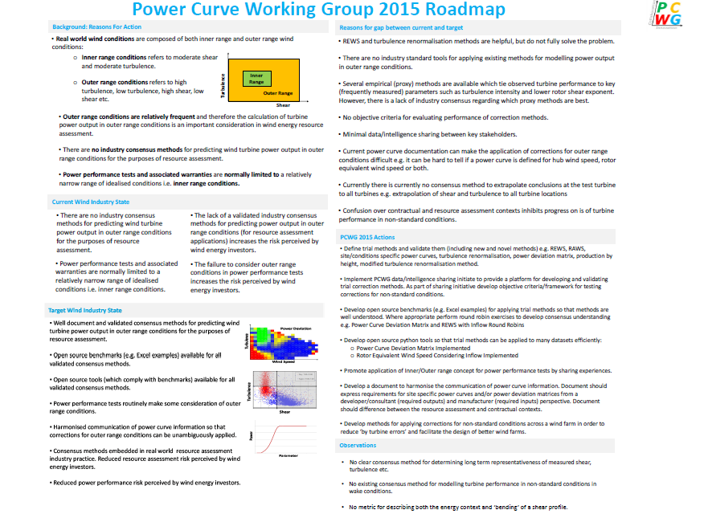
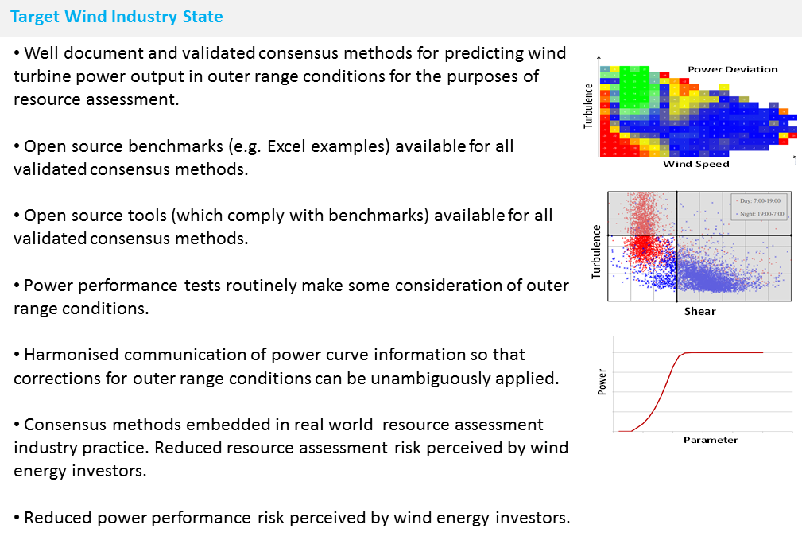
Download PCWG 2015 Roadmap from www.pcwg.org

Slide 6
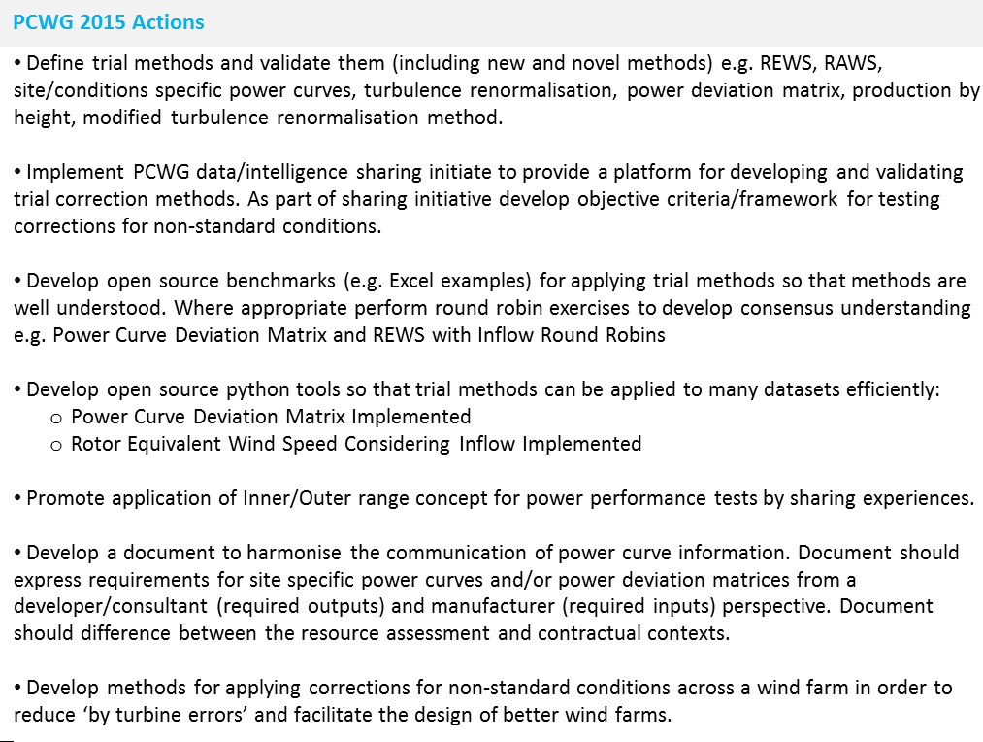
Intelligence Sharing Initiative
Turbine Performance Information Pack
Download PCWG 2015 Roadmap from www.pcwg.org

Slide 7
PCWG Intelligence Sharing Initiative
A key focus of the PCWG during 2015 is the 1st PCWG Intelligence Sharing Initiative (PCWG-Share-01).
Propose
Test
Aggregate
Disseminate
Decide on methods to be tested
Evaluate performance of trial methods on each individual dataset
Combine performance metrics of all datasets
Publically disseminate results
The initiative aims to aggregate information across organization boundaries in order to deliver a step change in industry understanding of turbine performance.
The existence of Open Source Excel Benchmarks has been defined as a prerequisite for the inclusion of a method in PCWG-Share-X.

Slide 8
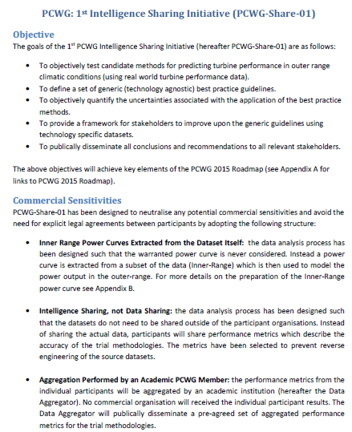
PCWG Intelligence Sharing Initiative
The proposed structure of PCWG-Share-01 has been captured in a “definition document” which has now been finalised and circulated to PCWG members.
Final definition document is available at www.pcwg.org.

Slide 9
PCWG-Share-01: Data Flow
Hypothesis/Trial Methodology
Analysis Definition Y
Analysis Definition Y
Analysis Definition Y
Analysis Definition Y
Proprietary Dataset A
Proprietary Dataset B
Proprietary Dataset C
Proprietary Dataset D
Organization A
Organization B
Organization C
Organization D
Hypothesis Performance Metrics
Aggregator
(Academic Institution )
Combination Analysis
How well did the trial method perform?
Aggregated Hypothesis Performance Metrics

Slide 10
PCWG-Share-01: Timeline
Finalise Definition Doc
Finalise Analysis Tool
PCWG Participants work to set up their proprietary datasets
Aggregate Initial results + Present
PCWG Participants perform further analysis
Aggregate final results + Present
Agree Conclusions
Time
June
July
Aug
Sep
Oct
Nov
Dec
Roskilde
PCWG Meeting
US PCWG Meeting
Aarhus
PCWG Meeting
London
PCWG Meeting
AWEA New Orleans
EWEA Paris

Slide 11
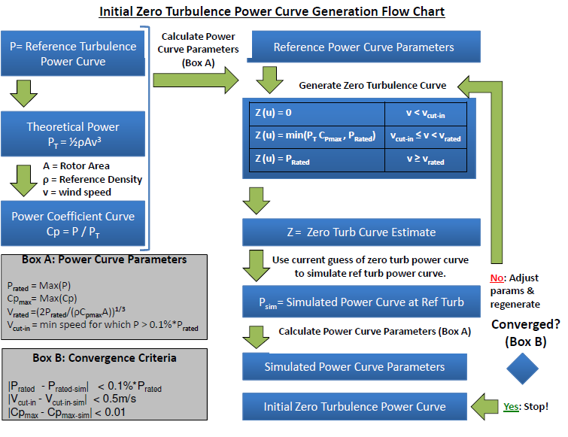
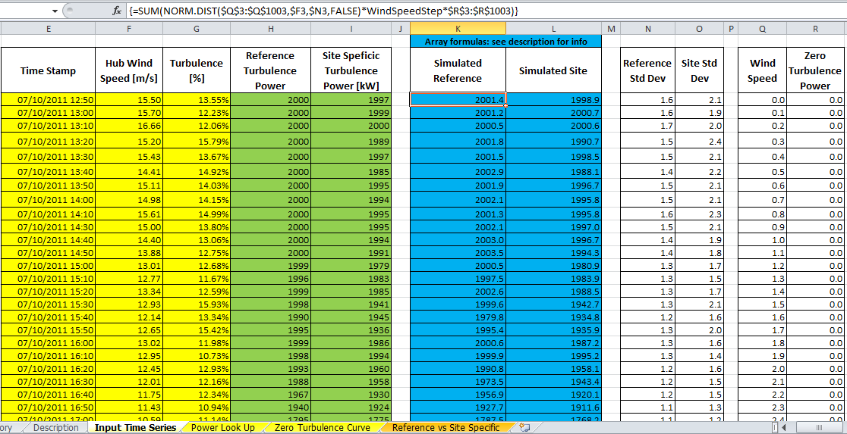
Open Source Excel Benchmarks
All methods examined by PCWG-Share-01 will have a publically available Benchmark.
Excel Consensus Analysis for IEC Turbulence Correction and Associated Documentation

Slide 12
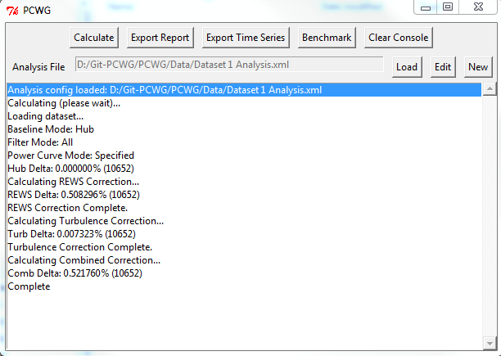
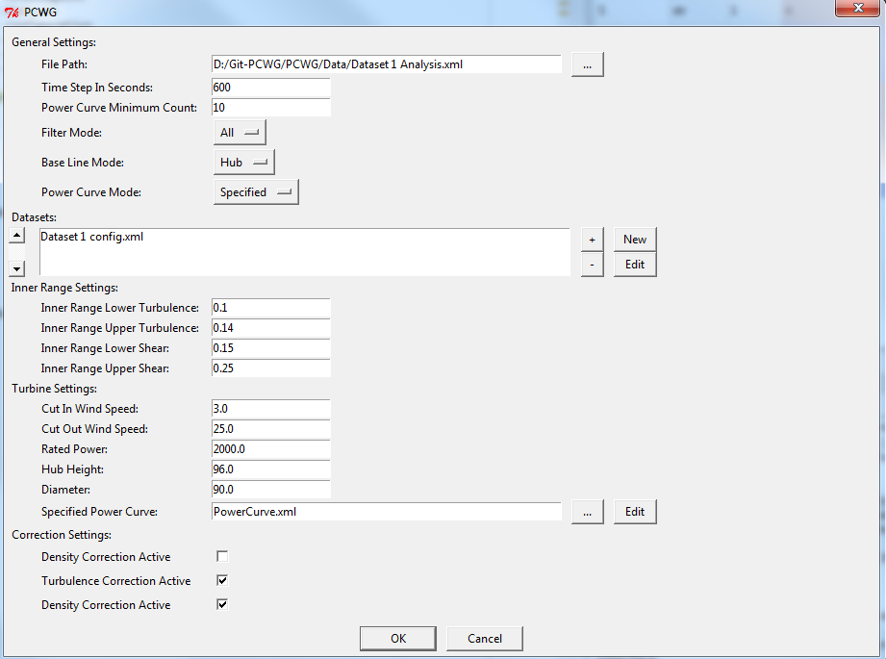
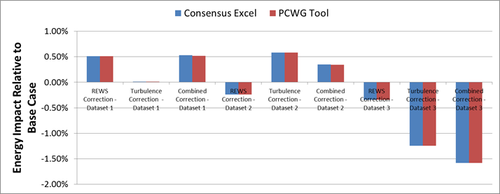
PCWG Analysis Tool
Excel Benchmark and PCWG Analysis Tool Comparison

Slide 13
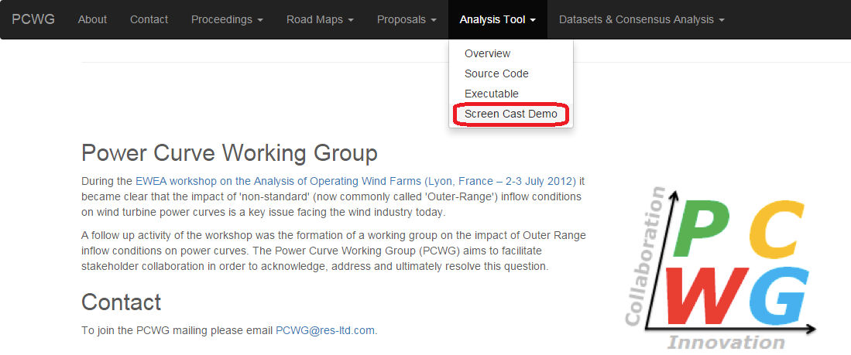
PCWG Screen Cast Demo
A step by step demo of setting up a dataset in the Analysis Tool has been published on the PCWG website:

Slide 14
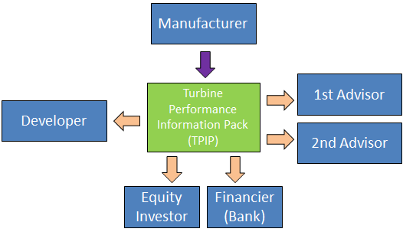
Harmonisation of Power Curve Communication
Another key action of the PCWG 2015 roadmap is the creation of a document to harmonise the communication of power curve information.
The guidelines aim to ensure that all stakeholders can confidently:
Understand the evidence base behind the documented turbine performance.
Understand what elements of the turbine performance data are warranted and what elements are purely informative.
Understand how to model turbine performance in Inner Range Conditions.
Understand how to model turbine performance in Outer Range Conditions.

Slide 15
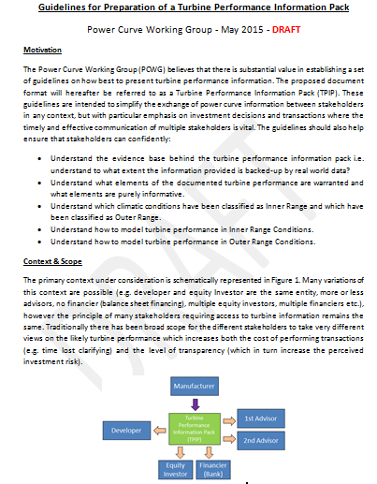
Harmonisation of Power Curve Communication
A DRAFT document “Guidelines for Preparation of a Turbine Performance Information Pack” has been circulated to members and will be discussed at the September and October PCWG meetings.
The current draft is available on DropBox: ‘DRAFT Guidelines for Preparation of a Turbine Performance Information Pack.docx’

Slide 16
15th September 2015 Agenda
Introduction: 10.00 – 11.00.
Intelligence Sharing Initiative: 11.00 – 13.00:
11.00 – 11.45 Initiative Definition Discussion (Scope, Schedule, Roles & Responsibilities)
11.45 – 12.15 Power Curve Working Group Analysis Tool
Quick Demo of setting up and analysing a dataset in the PCWG Analysis Tool
Discussion on readiness of Power Curve Working Group Analysis tool to support the data sharing initiative.
12.15 – 12.30 Thoughts from PCWG-Share-01 Participants
Presentation: PCWG Intelligence Sharing (a participants view), EDF.
Discussion
12.30 – 13.00 Candidate Methods for PCWG-Share-02
3D Power Deviation Matrix - Alex Head (Prevailing)
Production by Height – Dan Bernadette (AWS TruePower)
Machine Learning– Andy Clifton (NREL)

Slide 17
15th September 2015 Agenda
Lunch: 13.00 – 14.00.
Afternoon Presentation Session: 14.00 – 15.00:
14.00 – 14.20: Using turbine specific information to determine power performance a practical example - Taylor Geer (DNV GL)
14.20 – 14.40: The Potential to Use Mesoscale Models to Predict the Turbine Specific Frequency of Outer Range Conditions, Gil lizcano (Vortex)
14.40 – 15.00: A New Theoretical Basis for Describing Low Turbulence Wind Turbine Performance, Peter Stuart (RES)
Coffee Break 15.00 – 15.15
Afternoon Discussion Session 15.15 – 16.15: Discussion on draft turbine performance information pack guidelines document (harmonisation of communication action from roadmap).
Meeting Wrap Up 16.15 – 16.30
Intelligence Sharing Initiative Informal Working Session 16.30 – 18.30

Slide 18
Objectives for 15th September 2015
Gather US PCWG member feedback on the structure of PCWG-Share-01
Increase familiarity with the process of setting up datasets in the PCWG Analysis Tool
Discuss power curve information harmonisation document (turbine performance information pack)
Any other objectives for today?

